Slide 1

Discover RPI
Notes:
Aneesh

Slide 2
Hello! We are Team Marmalade
Simar
Bhavesh
Connor
Aneesh
Notes:
Aneesh

Slide 3
AGENDA
Description
Target Audience
Goal
What We Previously Did?
What Have We Done?
Demo
Future Plans
Q&A
Notes:
Aneesh

Slide 4
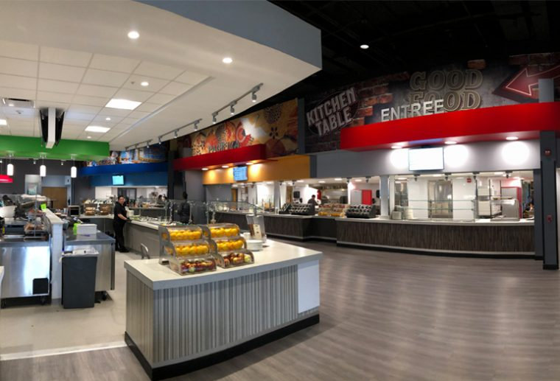
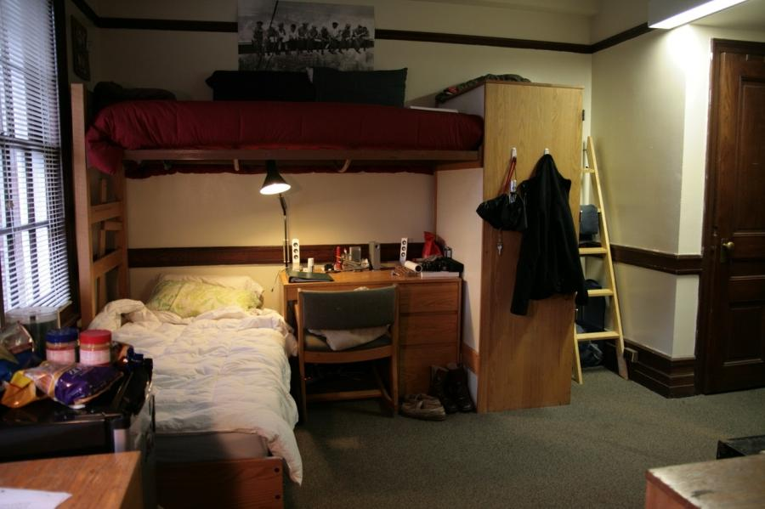
Description
Serves to provide users with a means to learn more about the dorms and what they have access to
Notes:
Aneesh

Slide 5
Target Audience
RPI Students
Potential Students and Family Members
Give prospective students an idea of what the facilities look like and what they’ll have access to
Notes:
Aneesh

Slide 6
Goal
Provide users with updated information about certain dorms and allow students to review them
Application capable of implementing comments for students who have lived in these dorms
Notes:
Simar

Slide 7
What we’ve Previously done
Frontend
Angular
NodeJS
JSON
Notes:
Bhavesh

Slide 8
Node + Express
Preparing for future technologies:
Ex. Mongo
Dorms
Dorm Information in JSON
Currently now in Database
Created API endpoints for frontend
Login Information
Converted to OAuth
Notes:
Bhavesh

Slide 9
Frontend
Designed frontend
Used html, css, js
Created pages such as:
Index
Login
Dashboard
Dorm
Notes:
Simar

Slide 10
Angular
Components:
Dashboard
Dorm
Homepage
Login
Logout
Styling + Formatting of Pages
Notes:
Simar

Slide 11
What We’ve Done
MongoDB
Dorms
Reviews
Gathering Data/Updated CSS
OAuth and Firebase
Data Visualizations
Notes:
Bhavesh

Slide 12
Gathered Data + CSS
Gathered More Photos for each individual dorm area
Now able to provide a successful slideshow with photos for each dorm
Notes:
Aneesh

Slide 13
MongoDB
Created database for Discover RPI with 2 collections:
Reviews
Dorms
Created endpoints to call data from MongoDB to their respective places in application
Notes:
Connor

Slide 14
Dorms
Individual Dorms pages now get data from the database itself
Includes features of the dorm itself
Created endpoints to call from database
Notes:
Connor

Slide 15
Reviews
After logging in, users are now able to post reviews/comments about certain dorms and their experiences
Reviews stored in MongoDB collection under “Reviews”
ID is based on the dorm nickname
Created endpoints to call from database
Notes:
Connor

Slide 16
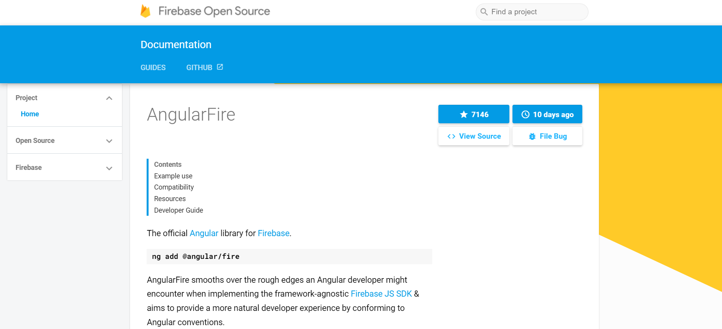
OAuth + Firebase
‘angularfire’ (Angular library for Firebase) is used to implement Google authentication
An ‘auth’ service (which communicates with Firebase) is used to handle the authentication process
Components can also use this service to get login information
Notes:
Bhavesh

Slide 17
Data Visualizations
Created D3 Data Visualizations:
Visualization 1:
Individual Dorm Reviews
Visualization 2:
Average Score for Reviews (All Dorms)
Notes:
Simar

Slide 18
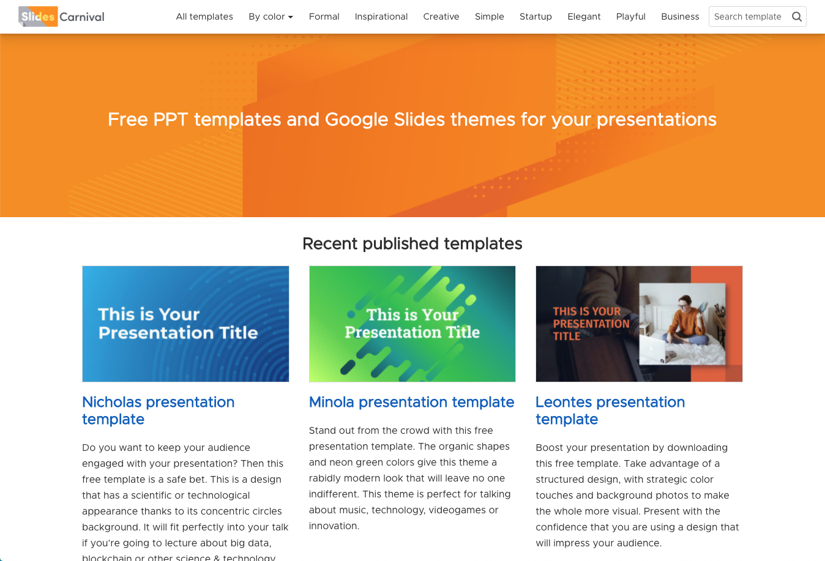
DEMO

Slide 19
Future Plans
Different Building Types
Upvotes
Verification of RPI student/alumni
Notes:
Simar

Slide 20
THANKS!
Any questions?

